Slide 1
Fixing a Bug with Updating the Quantity

Slide 2
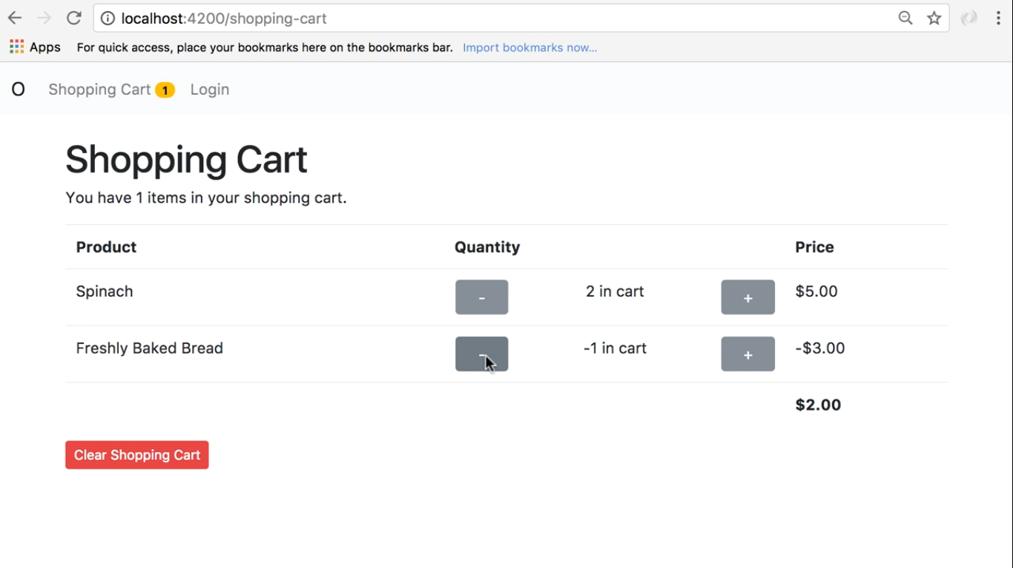

Slide 3
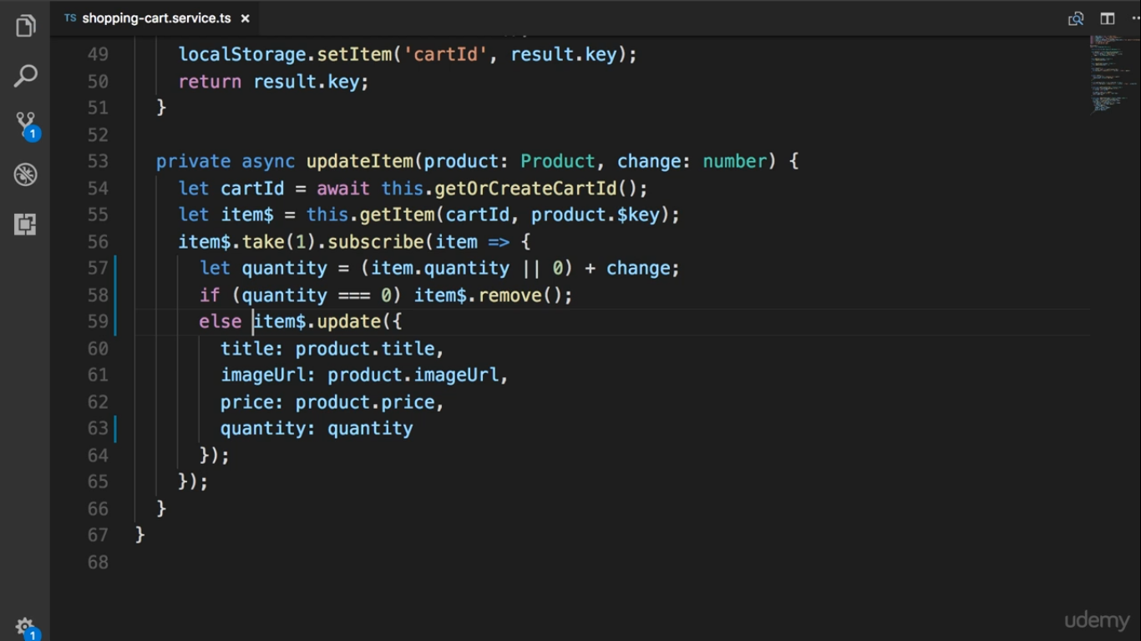

Slide 4
